Slide 1
Chapter 6
Object Modeling

Slide 2
Learning Objectives (1 of 2)
After this chapter, you will be able to:
Demonstrate how object-oriented analysis can be used to describe an information system
Explain what an object represents in an information system
Explain object attributes
Explain object methods
Explain object messages
Explain classes

Slide 3
Learning Objectives (2 of 2)
Explain relationships among objects and classes
Draw an object relationship diagram
Demonstrate use of the UML to describe object-oriented systems, including use cases, use case diagrams, class diagrams, sequence diagrams, state transition diagrams, activity diagrams, and business process models
Explain how tools can support object modeling

Slide 4
Object-Oriented Analysis
Methodology is popular
Integrates easily with object-oriented programming languages such as C++, Java, and Python
Modular, reusable, and easy to maintain
End product of O-O analysis is an object model
Represents the information system in terms of objects and O-O concepts

Slide 5
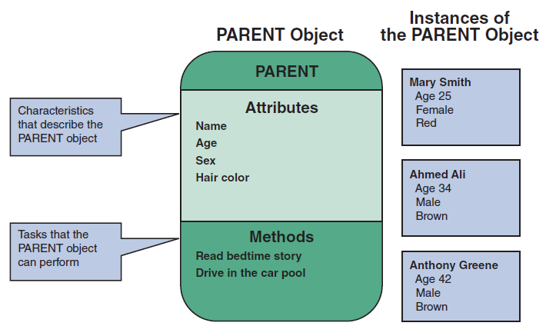
Objects (1 of 2)
Person, place, event, or transaction that is significant to the information system
FIGURE 6-1 The PARENT object includes four attributes and two methods. Mary Smith, Ahmed Ali, and Anthony Greene are instances of the PARENT object.

Slide 6
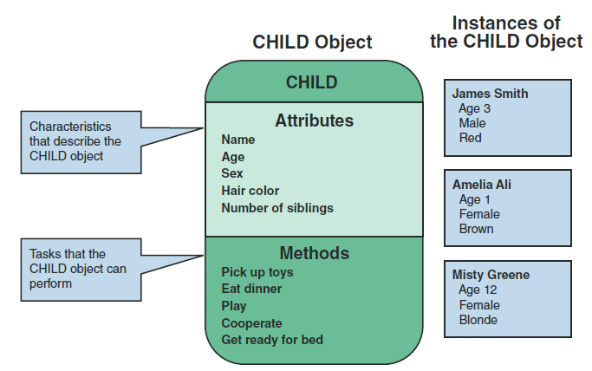
Objects (2 of 2)
FIGURE 6-2 The CHILD object includes five attributes and five methods. James Smith, Amelia Ali, and Misty Greene are instances of the CHILD object.

Slide 7
Attributes
Describe the characteristics of an object
Attributes of an object are defined during the system development process
Objects possess a state
Describes the object’s current status

Slide 8
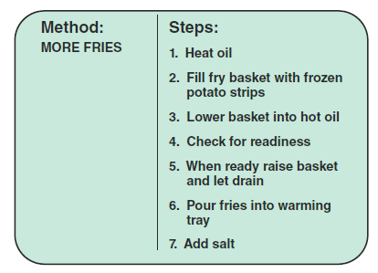
Methods
Tasks or functions that the object performs when it receives a message, or command
FIGURE 6-3 The MORE FRIES method requires the server to perform seven specific steps.

Slide 9
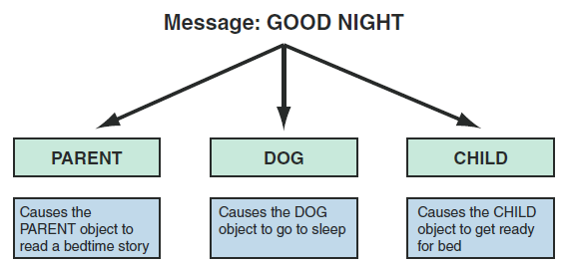
Message (1 of 2)
Command that tells an object to perform a certain method
Polymorphism: message gives different meanings to different objects
FIGURE 6-4 In an example of polymorphism, the message GOOD NIGHT produces different results, depending on which object receives it.

Slide 10
Message (2 of 2)
Message to the object triggers changes within the object without specifying how the changes must be carried out
An object can be viewed as black box
Encapsulation: idea that all data and methods are self-contained

Slide 11
Classes (1 of 3)
An object belongs to a group or category called a class
All objects within a class share common attributes and methods
Subclasses: categories within a class
Super-class: class belonging to a general category

Slide 12
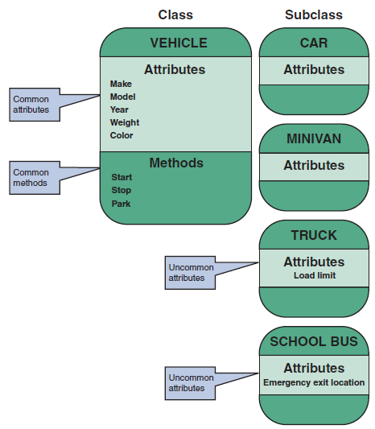
Classes (2 of 3)
FIGURE 6-6 The VEHICLE class includes common attributes and methods. CAR, TRUCK, MINIVAN, and SCHOOL BUS are instances of the VEHICLE class.

Slide 13
Classes (3 of 3)
FIGURE 6-8 At the fitness center, the PERSON superclass includes common attributes and methods. EMPLOYEE is a class within the PERSON superclass. INSTRUCTOR is a subclass within the EMPLOYEE class.

Slide 14
Relationships Among Objects and Classes (1 of 3)
Relationships
Enable objects to communicate and interact as they perform business functions and transactions
Describe what objects need to know about each other
Inheritance
Strongest relationship
Enables an object to derive one or more of its attributes from another object

Slide 15
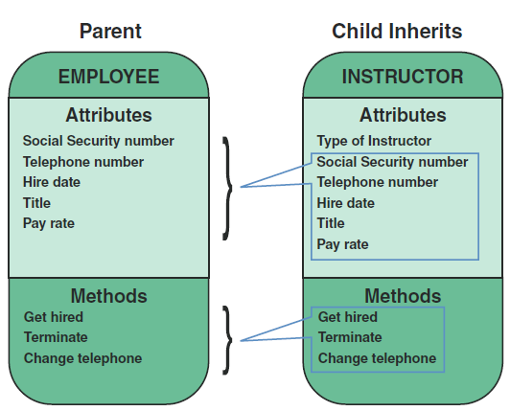
Relationships Among Objects and Classes (2 of 3)
FIGURE 6-9 An inheritance relationship exists between the INSTRUCTOR and EMPLOYEE objects. The INSTRUCTOR (child) object inherits characteristics from the EMPLOYEE (parent) class and can have additional attributes of its own.

Slide 16
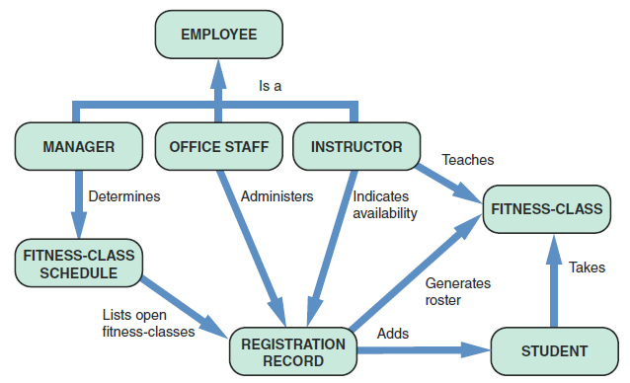
Relationships Among Objects and Classes (3 of 3)
FIGURE 6-10 Object relationship diagram for the fitness center.

Slide 17
The Unified Modeling Language (1 of 15)
Uses a set of symbols to represent graphically the various components and relationships within a system
Use case modeling
Use case: represents steps in a specific business function or process
An external entity, called an actor, initiates a use case by requesting the system to perform a function or process

Slide 18
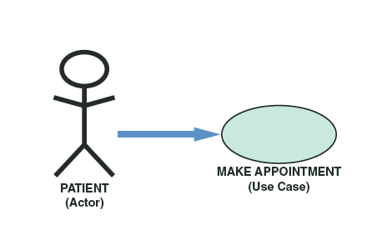
The Unified Modeling Language (2 of 15)
Use case description
Documents the name of the use case, the actor, a description of the use case
Provides a step-by-step list of the tasks and other key descriptions and assumptions
FIGURE 6-11 In a medical office system, a PATIENT
(actor) can MAKE APPOINTMENT (use case).

Slide 19
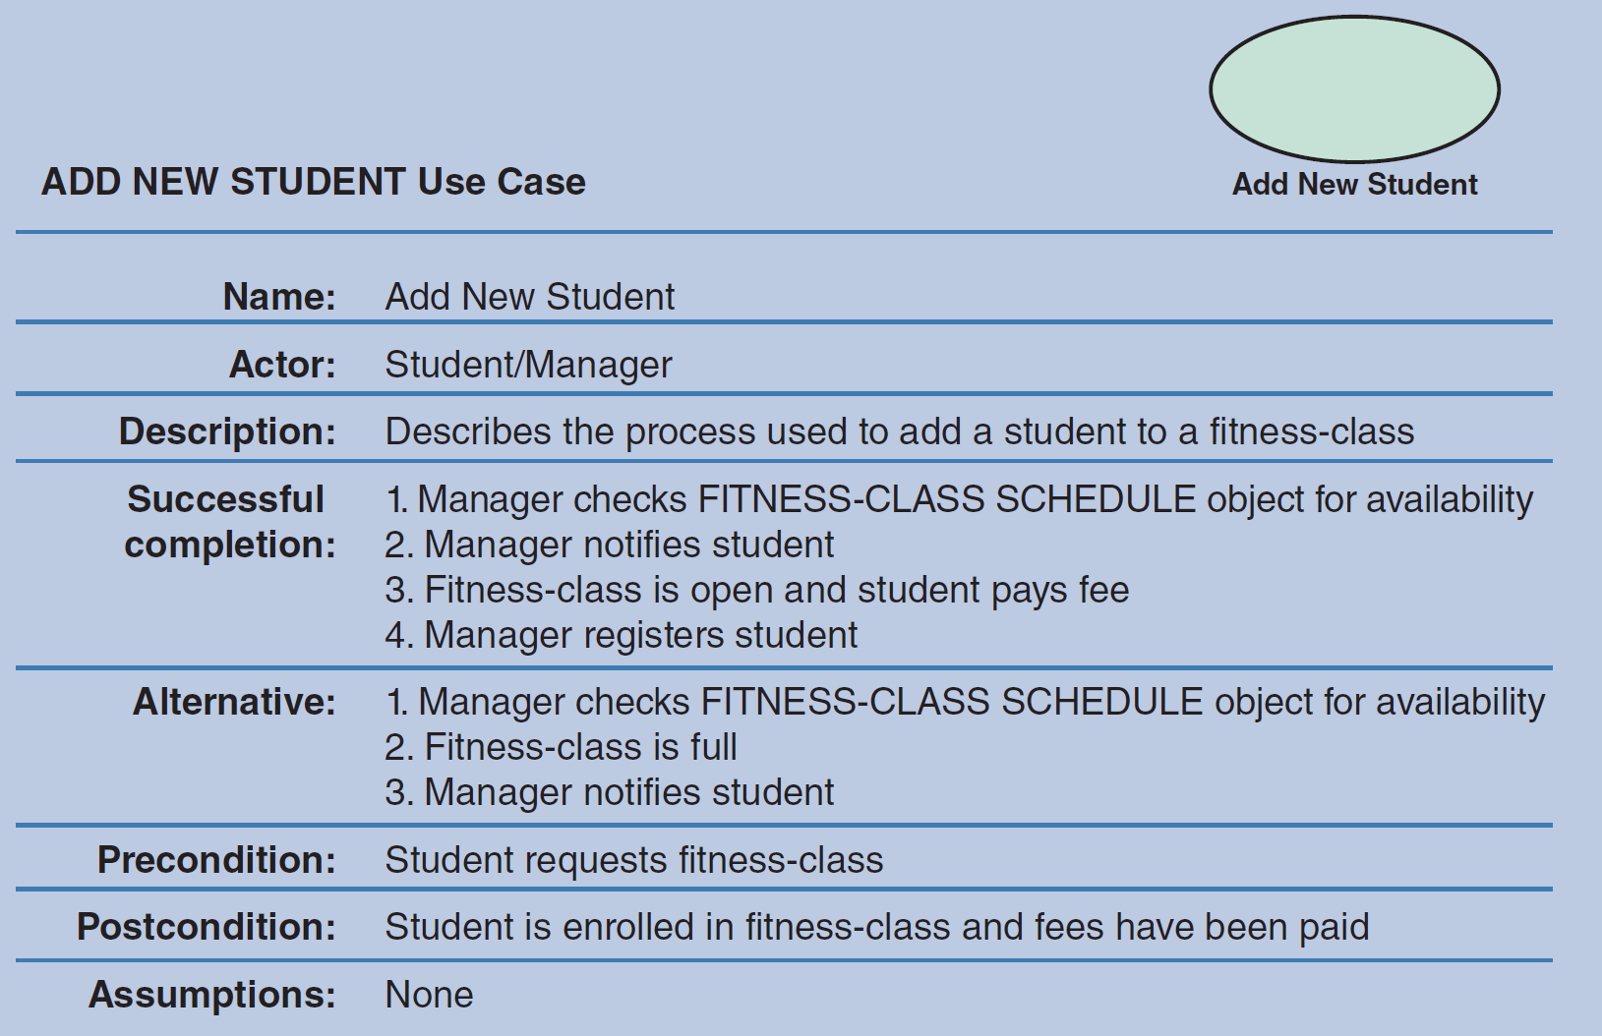
The Unified Modeling Language (3 of 15)
FIGURE 6-13 The ADD NEW STUDENT use case description documents the process used to add a current student into an existing class at the fitness center.

Slide 20
The Unified Modeling Language (4 of 15)
Use case diagrams
Visual summary of several related use cases within a system or subsystem
The first step is to identify the system boundary which is represented by a rectangle
System boundary: shows what is included in the system (inside the rectangle) and what is not included in the system (outside the rectangle)

Slide 21
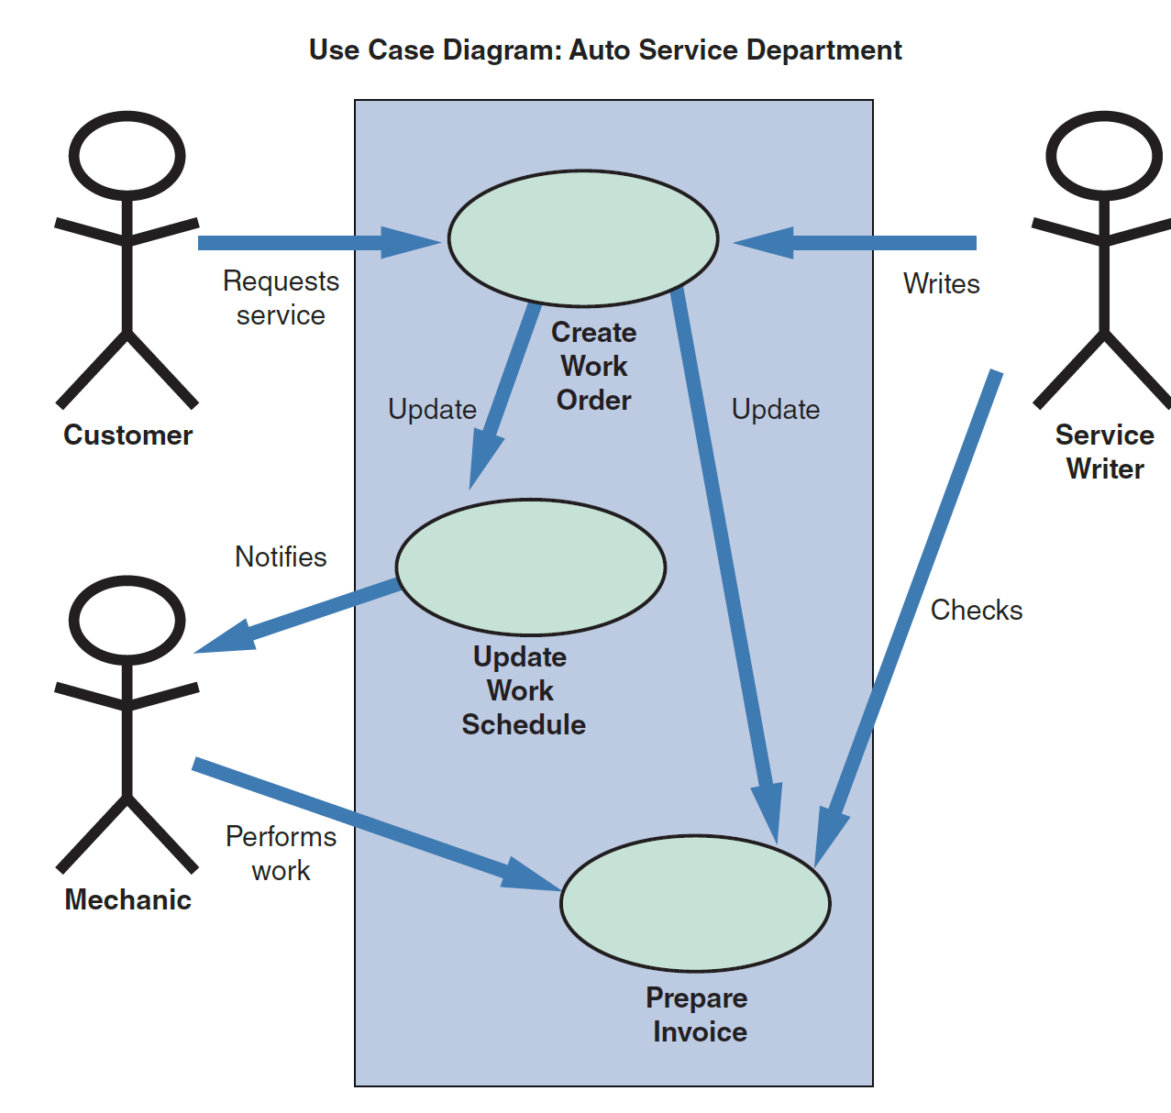
The Unified Modeling Language (5 of 15)
FIGURE 6-15 A use case diagram to handle work at an auto service department.

Slide 22
The Unified Modeling Language (6 of 15)
Class diagrams
Show the object classes and relationships involved in a use case
Each class appears as a rectangle, with the class name at the top, followed by the class’s attributes and methods
Lines show relationships between classes and have labels identifying the action that relates the two classes
Includes a concept called cardinality
Describes how instances of one class relate to instances of another class

Slide 23
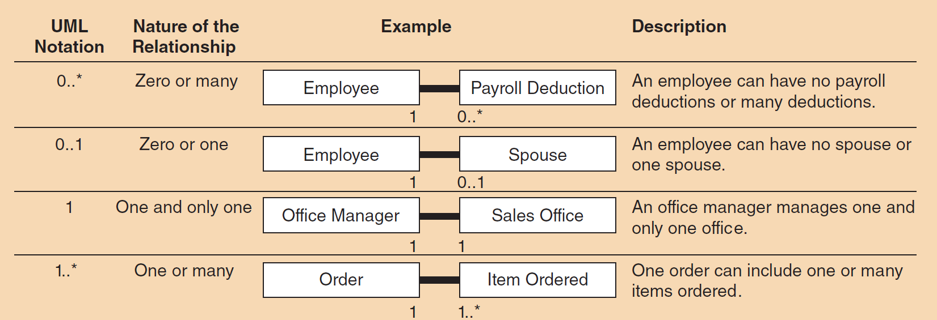
The Unified Modeling Language (7 of 15)
FIGURE 6-16 Examples of UML notations that indicate the nature of the relationship between instances of one class and instances of another class.

Slide 24
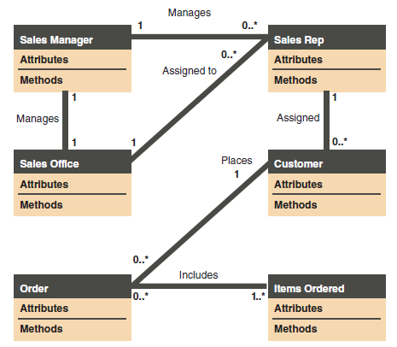
The Unified Modeling Language (8 of 15)
FIGURE 6-17 Class diagram for a sales order use case (attributes and methods omitted for clarity).

Slide 25
The Unified Modeling Language (9 of 15)
Sequence diagrams
Dynamic model of a use case, showing the interaction among classes during a specified time period
Graphically document the use case by showing classes, messages, and timing messages
Include symbols that represent classes, lifelines, messages, and focuses

Slide 26
The Unified Modeling Language (10 of 15)
Important terms
Classes: send or receive messages
Lifelines: represent the time during which the object above it is able to interact with the other objects in the use case
Messages: include additional information about the contents
Focuses: indicate when an object sends or receives message

Slide 27
The Unified Modeling Language (11 of 15)
FIGURE 6-18 A sequence diagram with two classes. Notice the X that indicates the end of the CLASS 2 lifeline. Also notice that each message is represented by a line with a label that describes the message, and that each class has a focus that shows the period when messages are sent or received

Slide 28
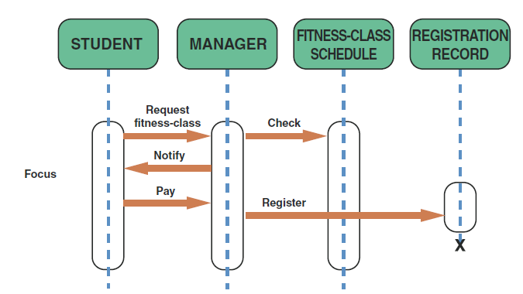
The Unified Modeling Language (12 of 15)
FIGURE 6-19 The sequence diagram for the ADD NEW STUDENT use case. The use case description for ADD NEW STUDENT is shown in Figure 6 14.

Slide 29
The Unified Modeling Language (13 of 15)
State transition diagrams
Show how an object changes from one state to another, depending on events that affect the object
All possible states must be documented in the state transition diagram
States appear as rounded rectangles with the state names inside

Slide 30
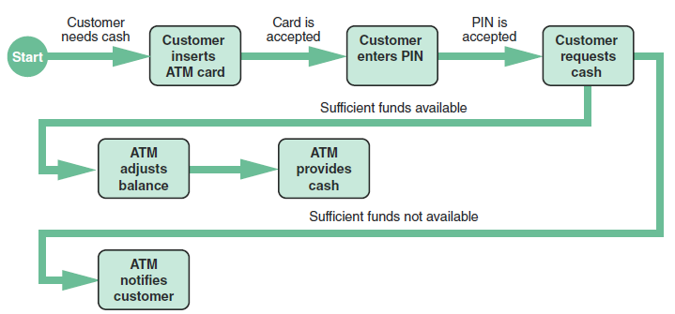
The Unified Modeling Language (14 of 15)
Activity diagrams
Show actions and events as they occur
Show the order in which the actions take place and identify the outcomes
FIGURE 6-21 An activity diagram shows the actions and events involved in withdrawing cash from an ATM.

Slide 31
The Unified Modeling Language (15 of 15)
Business process modeling (BPM)
Represents the people, events, and interaction in a system
Can be used anytime during the systems development process
Compatible with object modeling

Slide 32
Tools
Object modeling requires many types of diagrams to represent the proposed system
Systems analysts rely on tools to speed up the process and provide an overall framework for documenting
CASE tools
Systems modelling tools

Slide 33
Summary (1 of 2)
Object modeling is a popular technique that describes a system in terms of objects
Object-oriented terms include attributes, methods, messages, and classes
Objects can send messages, or commands, that require other objects to perform certain methods, or tasks

Slide 34
Summary (2 of 2)
Unified Modeling Language (UML) is a widely used method of visualizing and documenting an information system
Use case describes a business situation initiated by an actor, who interacts with the information system
CASE tools provide an overall framework for system documentation

